Slide 1




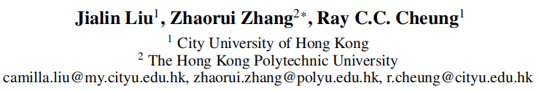





ATAI
Advanced Technique of Artificial Intelligence
ATAI
ChongqingUniversity _{AdvancedTechniqueof}
of Technology Artificial Intelligence
Chongqing University of Technology
Chongqing University ^{ATAI}
_{of Technology} Advanced Techniqueof
Artificial Intelligence
Chongqing University of Technology
Chongqing University of Technology
MoToRec: Sparse-Regularized Multimodal Tokenization for Cold-Start
Recommendation
code: None
—— AAAI ’26
Reported by Junsi Chen
1

Slide 2

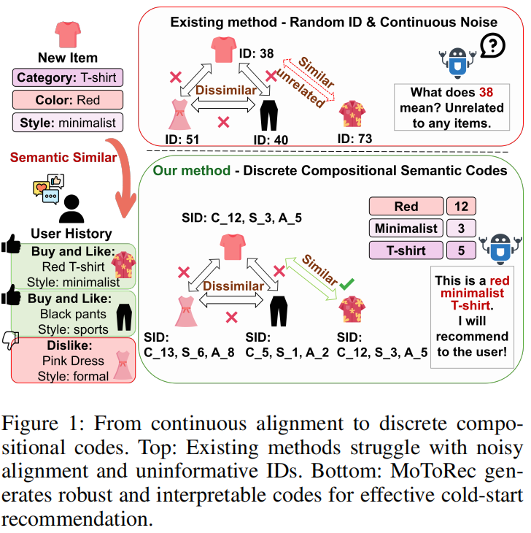
ATAI
AdvancedTechniqueof
Artificial Intelligence
ATAI
ChongqingUniversity _{AdvancedTechniqueof}
of Technology Artificial Intelligence
ChongqingUniversity of Technology
Motivation
(1) GNNs relies on dense historical data, exposing a critical vulnerability that manifests as a sharp performance decline in the face of data sparsity, particularly the persistent item cold-start problem.
(2) These approaches are all fundamentally hampered by a shared challenge: the inherent ambiguity and noise in high-dimensional vector alignment. We term this phenomenon the “semantic fog”. It makes mapping a concept like a “red T- shirt” from pixel-based and text-based vectors into a single, coherent point in a high-dimensional space a noise-sensitive and unreliable task.

Slide 3

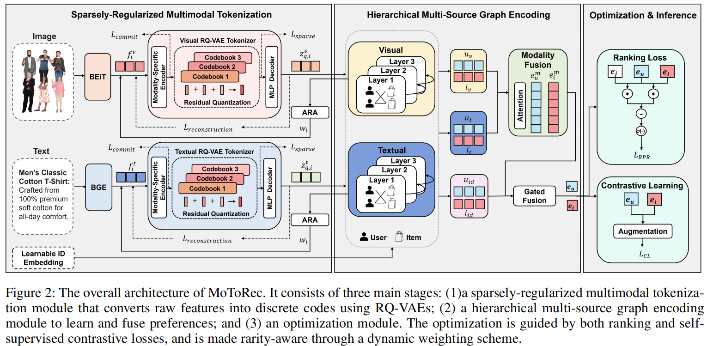
ChongqingUniversity of Technology
ATAI
AdvancedTechniqueof
Artificial Intelligence
ATAI
ChongqingUniversity _{AdvancedTechniqueof}
of Technology Artificial Intelligence
Overview

Slide 4
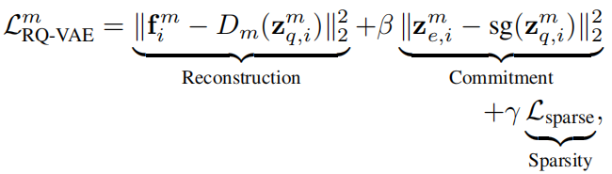

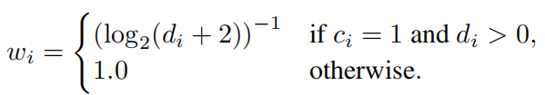




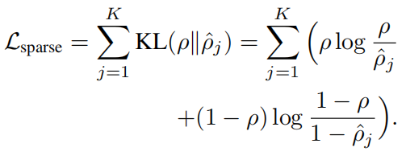
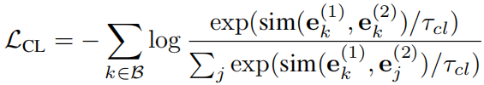
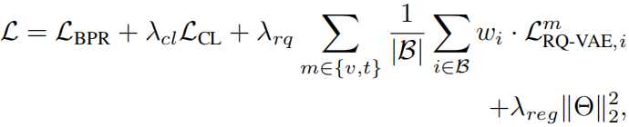
ChongqingUniversity of Technology
ATAI
AdvancedTechniqueof
Artificial Intelligence
ATAI
ChongqingUniversity _{AdvancedTechniqueof}
of Technology Artificial Intelligence
Method
(1)
(6)
(2)
(7)
(3)
(8)
(4)
(9)
(5)
(10)
(11)

Slide 5

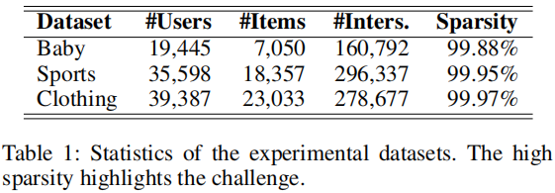
ATAI
Advanced Technique of Artificial Intelligence
ATAI
ChongqingUniversity _{AdvancedTechniqueof}
of Technology Artificial Intelligence
Chongqing University of
Technology
Chongqing University ^{ATAI}
_{of Technology} Advanced Techniqueof
Artificial Intelligence
Chongqing University of Technology
Chongqing University of Technology

Slide 6
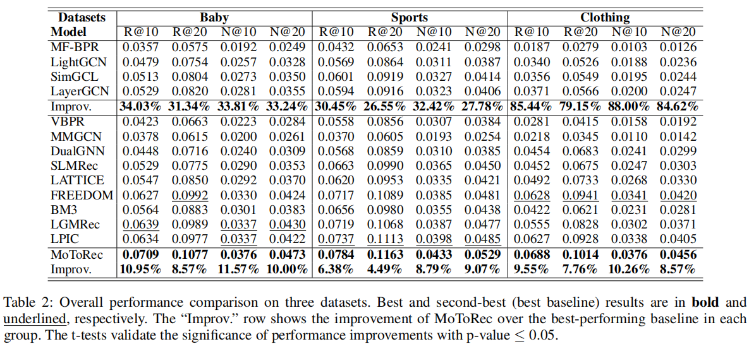
ATAI
Advanced Technique of Artificial Intelligence
ATAI
ChongqingUniversity _{AdvancedTechniqueof}
of Technology Artificial Intelligence
Chongqing University of
Technology
Chongqing University ^{ATAI}
_{of Technology} Advanced Techniqueof
Artificial Intelligence
Chongqing University of Technology
Chongqing University of Technology

Slide 7
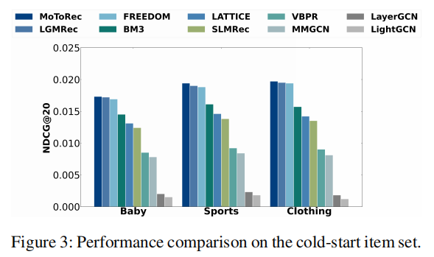
ATAI
Advanced Technique of Artificial Intelligence
ATAI
ChongqingUniversity _{AdvancedTechniqueof}
of Technology Artificial Intelligence
Chongqing University of
Technology
Chongqing University ^{ATAI}
_{of Technology} Advanced Techniqueof
Artificial Intelligence
Chongqing University of Technology
Chongqing University of Technology

Slide 8
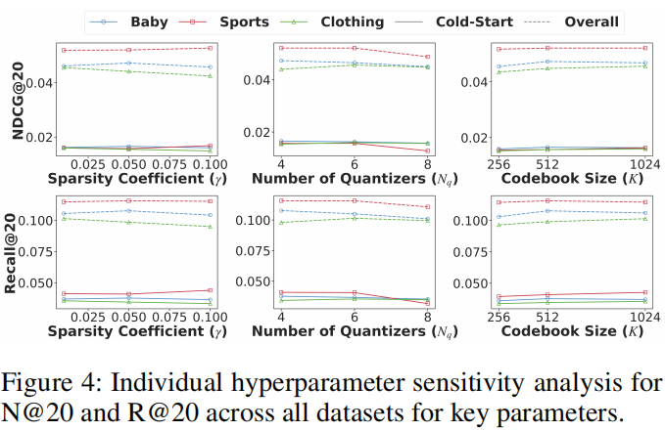
ATAI
Advanced Technique of Artificial Intelligence
ATAI
ChongqingUniversity _{AdvancedTechniqueof}
of Technology Artificial Intelligence
Chongqing University of
Technology
Chongqing University ^{ATAI}
_{of Technology} Advanced Techniqueof
Artificial Intelligence
Chongqing University of Technology
Chongqing University of Technology

Slide 9
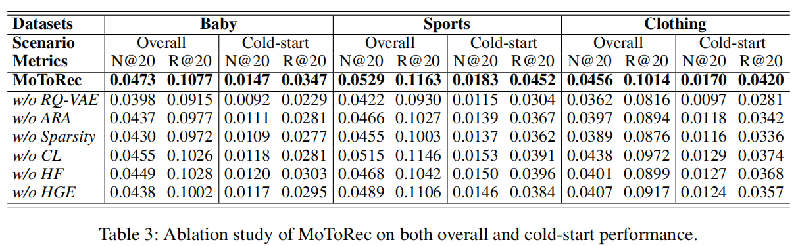
ATAI
Advanced Technique of Artificial Intelligence
ATAI
ChongqingUniversity _{AdvancedTechniqueof}
of Technology Artificial Intelligence
Chongqing University of
Technology
Chongqing University ^{ATAI}
_{of Technology} Advanced Techniqueof
Artificial Intelligence
Chongqing University of Technology
Chongqing University of Technology

Slide 10
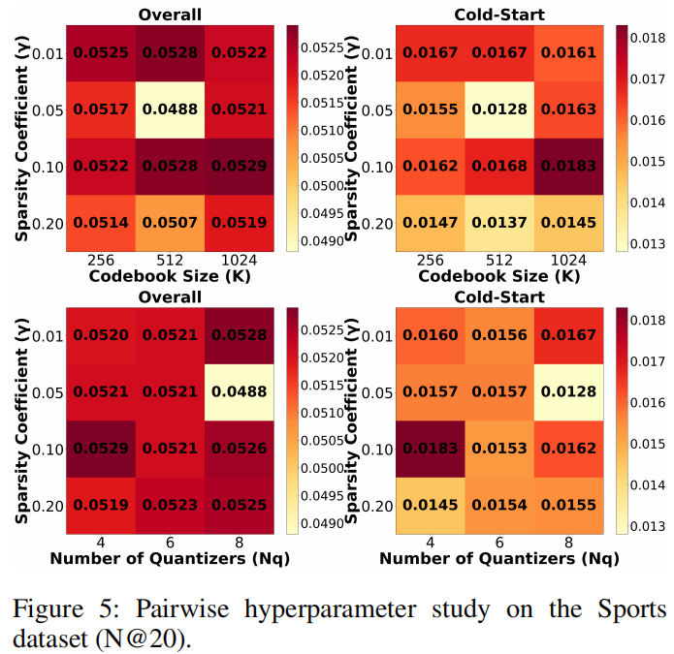
ATAI
Advanced Technique of Artificial Intelligence
ATAI
ChongqingUniversity _{AdvancedTechniqueof}
of Technology Artificial Intelligence
Chongqing University of
Technology
Chongqing University ^{ATAI}
_{of Technology} Advanced Techniqueof
Artificial Intelligence
Chongqing University of Technology
Chongqing University of Technology

Slide 11
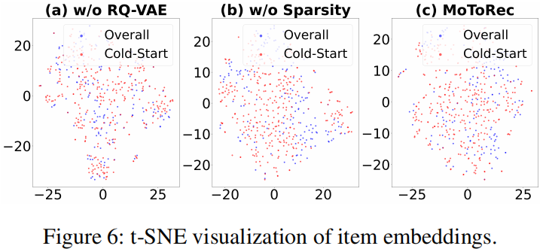
ATAI
Advanced Technique of Artificial Intelligence
ATAI
ChongqingUniversity _{AdvancedTechniqueof}
of Technology Artificial Intelligence
Chongqing University of
Technology
Chongqing University ^{ATAI}
_{of Technology} Advanced Techniqueof
Artificial Intelligence
Chongqing University of Technology
Chongqing University of Technology

Slide 12
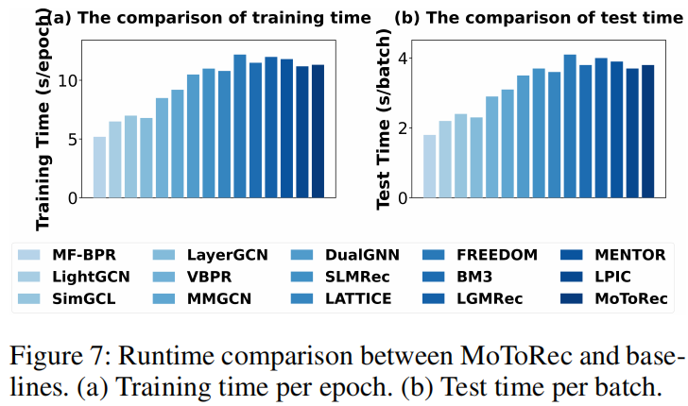
ATAI
Advanced Technique of Artificial Intelligence
ATAI
ChongqingUniversity _{AdvancedTechniqueof}
of Technology Artificial Intelligence
Chongqing University of
Technology
Chongqing University ^{ATAI}
_{of Technology} Advanced Techniqueof
Artificial Intelligence
Chongqing University of Technology
Chongqing University of Technology

Slide 13


ATAI
Advanced Technique of
Artificial Intelligence
ATAI
ChongqingUniversity _{AdvancedTechniqueof}
of Technology Artificial Intelligence
Chongqing University of Technology
Thanks!

